Slide 1

PBL Using 20% Time
Inquiry and Innovation in the JAG classroom
Derived from A.J. Juliani's book
"Inquiry and Innovation in the Classroom: Using 20% Time, Genius Hour, and PBL to Drive Student Success"
Niki Childers, JAG-Kansas, Dr. Amy Moore, iJAG & Karey Webb, JAG-Missouri

Slide 2
ATTENTION!!!
There is a shift in the Education Culture
Push for 21st Century Skills
Job Market Change
65% of the jobs "current" elementary school students will apply for have not been invented yet!
Work is more individualized and personalized
Employees have to brand themselves and show success in new and changing environments
Jobs will be contracted Out
Companies will not want to hire full-time employees because of:
  Space
  Benefits packages
  Often can fulfill the task from home

Slide 3

20% Time
Inquiry & Innovation
If you want to prepare your student for life "after" high school this method this learning method is vital to their success!!
We are no longer educating students to get a job and work there until retirement
  Stability/Comfort
  Skill Sets don’t change
It's used to explore their passions and what they like and/interested in.
This method has worked successful for companies such as Google,Yahoo, 3M

Slide 4


Case Study
"The Recession Proof Graduate"

Slide 5
What happened to Charlie?

Slide 6
Step #1
He stopped following the Rules that he learned in school, in the real world
  School says, "Your grades show others how motivated you are"
  Make sure to have your GPA on your resume, and send it to everyone
Stopped applying to low level jobs on Career Builder, Monster, Craiglist
  Created an online portfolio and reached out to people he wanted to learn from
  Offered "free work" in return for knowledge
  Self-Educated in the areas in which he wanted to work

Slide 7
Step #2
Charlie built a blog to go with his portfolio
  Shared his job failures and what he was going to do to change it
  Enabled him to be "Googleable"
  Told a story that supported his mission and goals

Slide 8
Step #3
He wrote "The Recession Proof Graduate"
  Downloaded over 150,000 times
  2 Ted Talks
  Helped others reach the New York Times' best sellers list
  Worked with other authors to help them launch their books
  All before the age of 30

Slide 9

Leading the Change in your JAG classroom
When teachers are asked why don’t you bring inquiry in the classroom?
  "Don’t have enough time"
"Focus on standards"

Slide 10
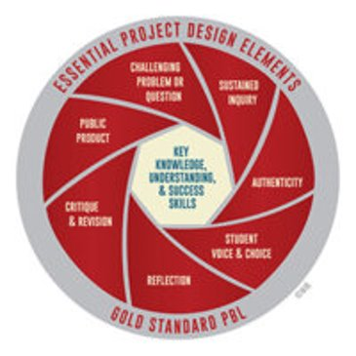

You have the Advantage!!

Slide 11
Example of Using 20% Time in the JAG Classroom
Jay Ace
Chisholm Trail Middle School
Newton, KS

Slide 12
Ways to incorporate
Inquiry and Innovation in your JAG classroom
20% of Class time (week/day)= YOUR VISION​
Gain trust (new way of learning)​
Tell them WHY (share your vision)​
Support the "Tinkering" and "Critical Thinking" process​
Share and Reflect with your team​
Instruction fueled by technology​
BYOD (Bring your own device)​

Slide 13

How does it work?
Brainstorm a way to explore their passions
Research resources on the topic
Write reflections and informational pieces on what they learned
Share and collaborate with other students
Reach out to experts
Create a product (understand their work)
Reflect on work (classmates)
Share with the world

Slide 14

What Does It Look Like?
(Sample session)
Getting Started
Dig Deeper
Vision/Idea
"What Do you Do when no one is "Telling you what to do"?
What do I do on the weekends?
What do I do after school?
What do I watch on TV? (if you don’t watch TV what do you do)?
Now get to the Why?

