Slide 1
Career Scavenger Hunt
Here starts the lesson!

Slide 2
As Freshman and Sophomores, you are just beginning to figure out what you want to do after high school.
This activity is meant to help you do that! After this activity, you may know what classes you need to take for your career.

Slide 3
Table of Contents!
Overview
Assignment
Answer questions about the careers shown and find your best fit.
Complete the career Scavenger Hunt and have fun! Then write an essay about your results and experience.

Slide 4
LESSON OVERVIEW

Slide 5
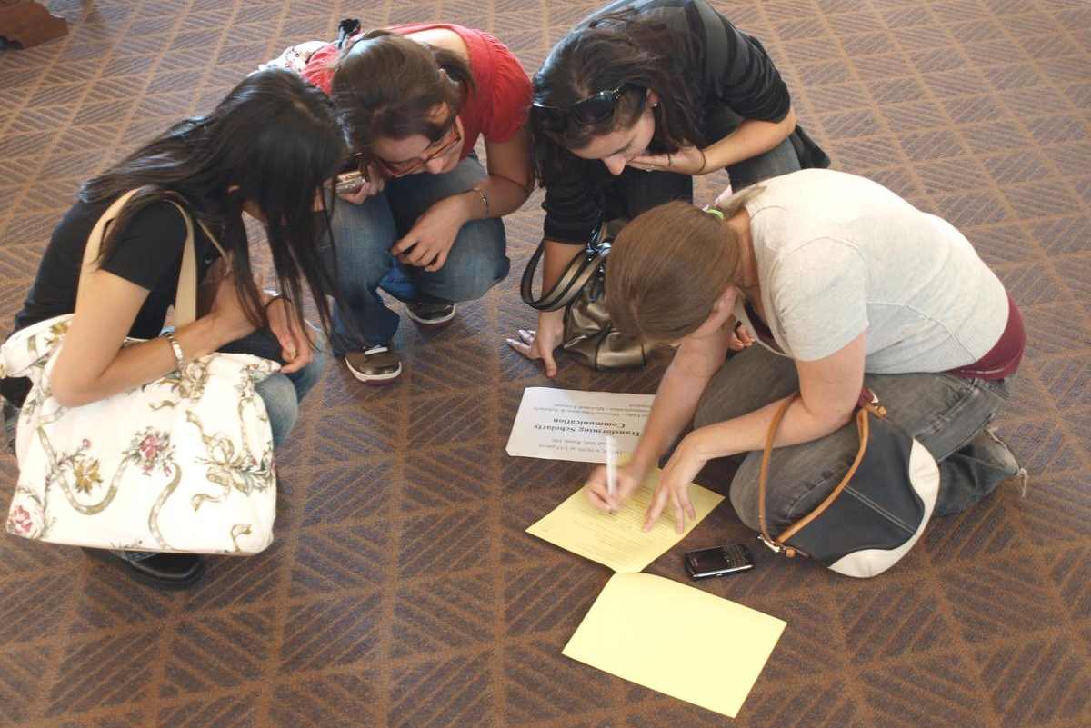
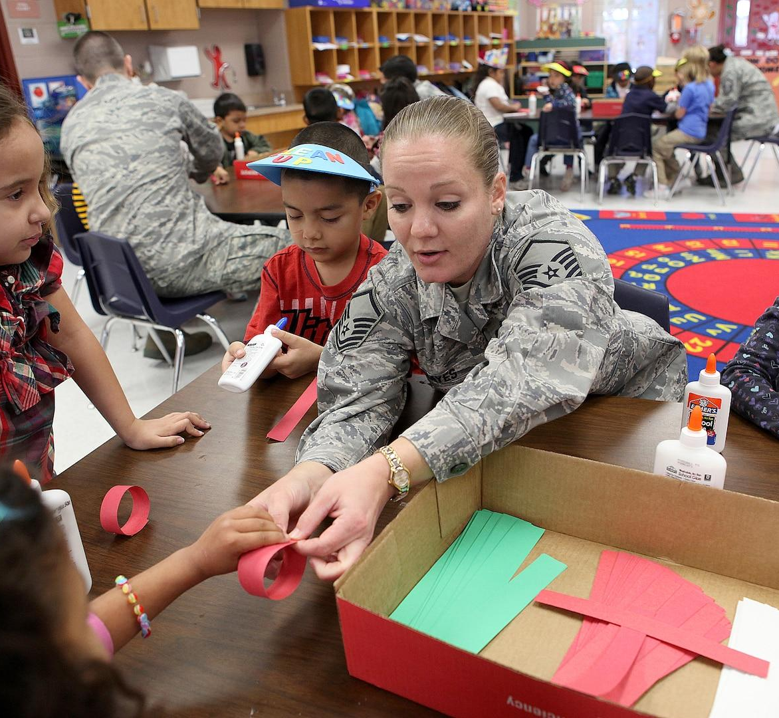
Introduction
You are going to compete in a career exploration Scavenger Hunt!
The goal of this is to figure out what you’d like to do after high school and learn some fun facts along the way!

Slide 6
Science
Business
Labor
Education
Arts
Public Works
FIND YOUR DREAM CAREER!
There are going to be six career clusters related to the workforce with five questions relating to each:

Slide 7
Activity Guidelines
You will be working in pairs. Choose a partner that shares your interests.
If you get a question wrong, you must write an explanation for the correct answer.
Working with a partner

Slide 8
WINNERS
1st Place- 3 choice snacks each
2nd Place- 2 choice snacks each
3rd Place- 1 choice snack each

Slide 9
Concept/Purpose
Are you content with your results?
REFLECTION
Learn more about different career fields
Find out what you know about the career fields
Find what INTERESTS you!

Slide 10
Pick A Topic
Questions To Consider
“Why do you like this career?”
“How would this career fit your lifestyle?”
“What makes this career interesting?”
Pick one of the careers you learned about and write an essay.

Slide 11
Question Example
How many years does it take to become a doctor?
Is the school time worth the salary?

Slide 12
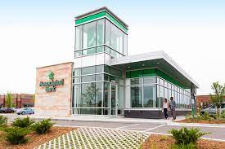
Question Example
What education is needed to be a banker?
Do bankers work a lot?

Slide 13
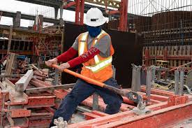
Question Example
What is a construction worker’s salary?
Do construction workers get healthcare?

Slide 14
95%
65%
100%
Impact/Results From Project
of students said they learned something new about their career choice!
of students felt that they gained more interest in a specific career!
of students said they had fun during this activity! :)

Slide 15
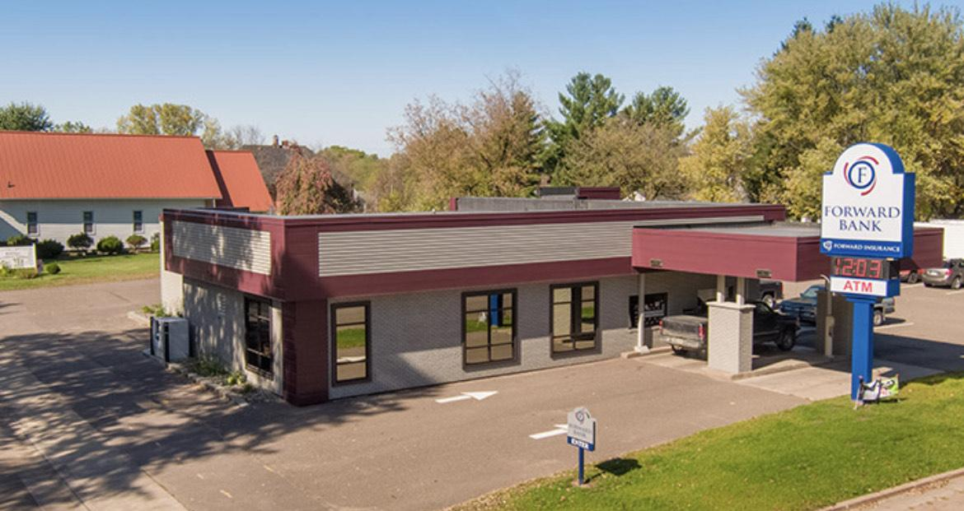
Forward Bank
Education Required:
Bachelor’s Degree
Career Focus:
Mathematics
Wisconsin based financial institution

Slide 16
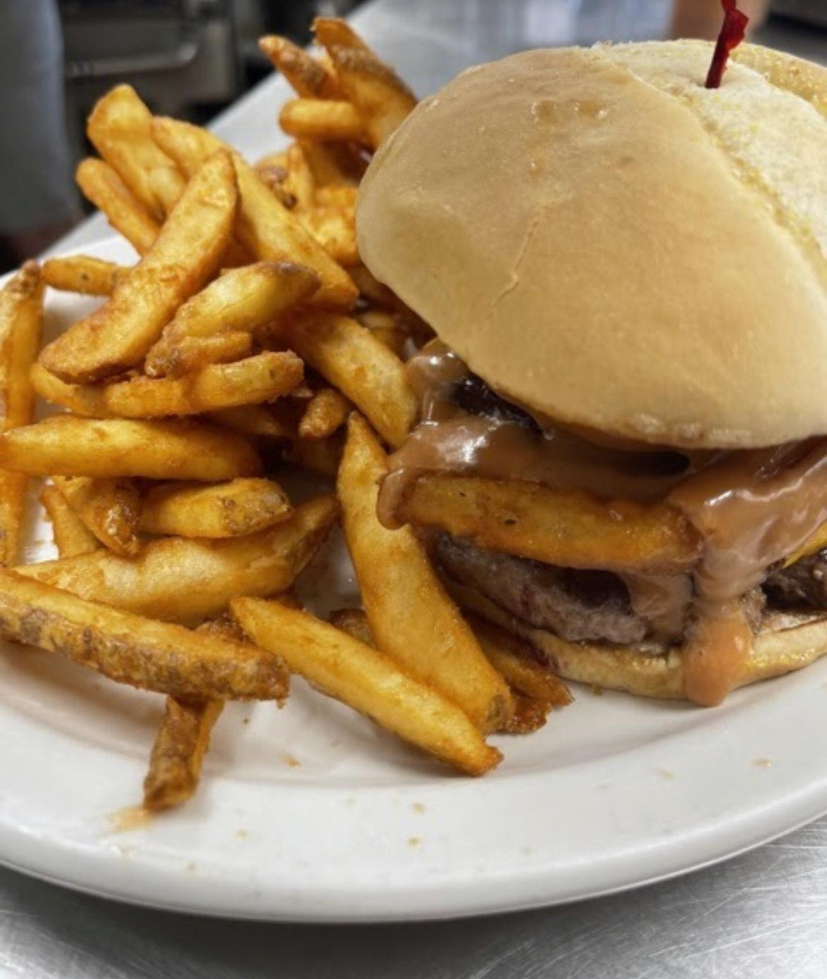
Debbie’s On Broadway
Started her family-owned restaurant in 2021
Duties:
Cooking
Cleaning
Customer Service
Restaurant Entrepreneur
Local Business
No College Degree Required

Slide 17
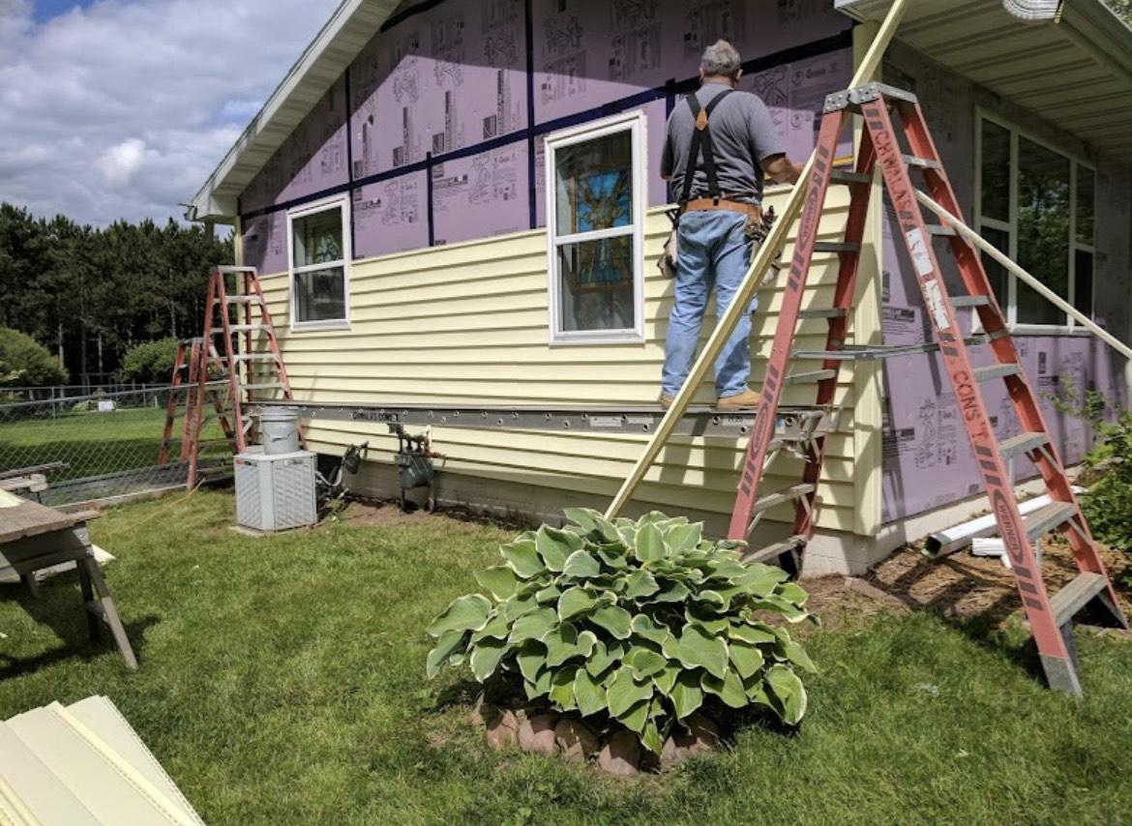
Chwala’s Construction
Family Owned Business
No College Degree Required
Services:
Remodels
Additions
Decks and porches
Etc.
Career Focus:
Manual Labor
Local Construction Business

Slide 18
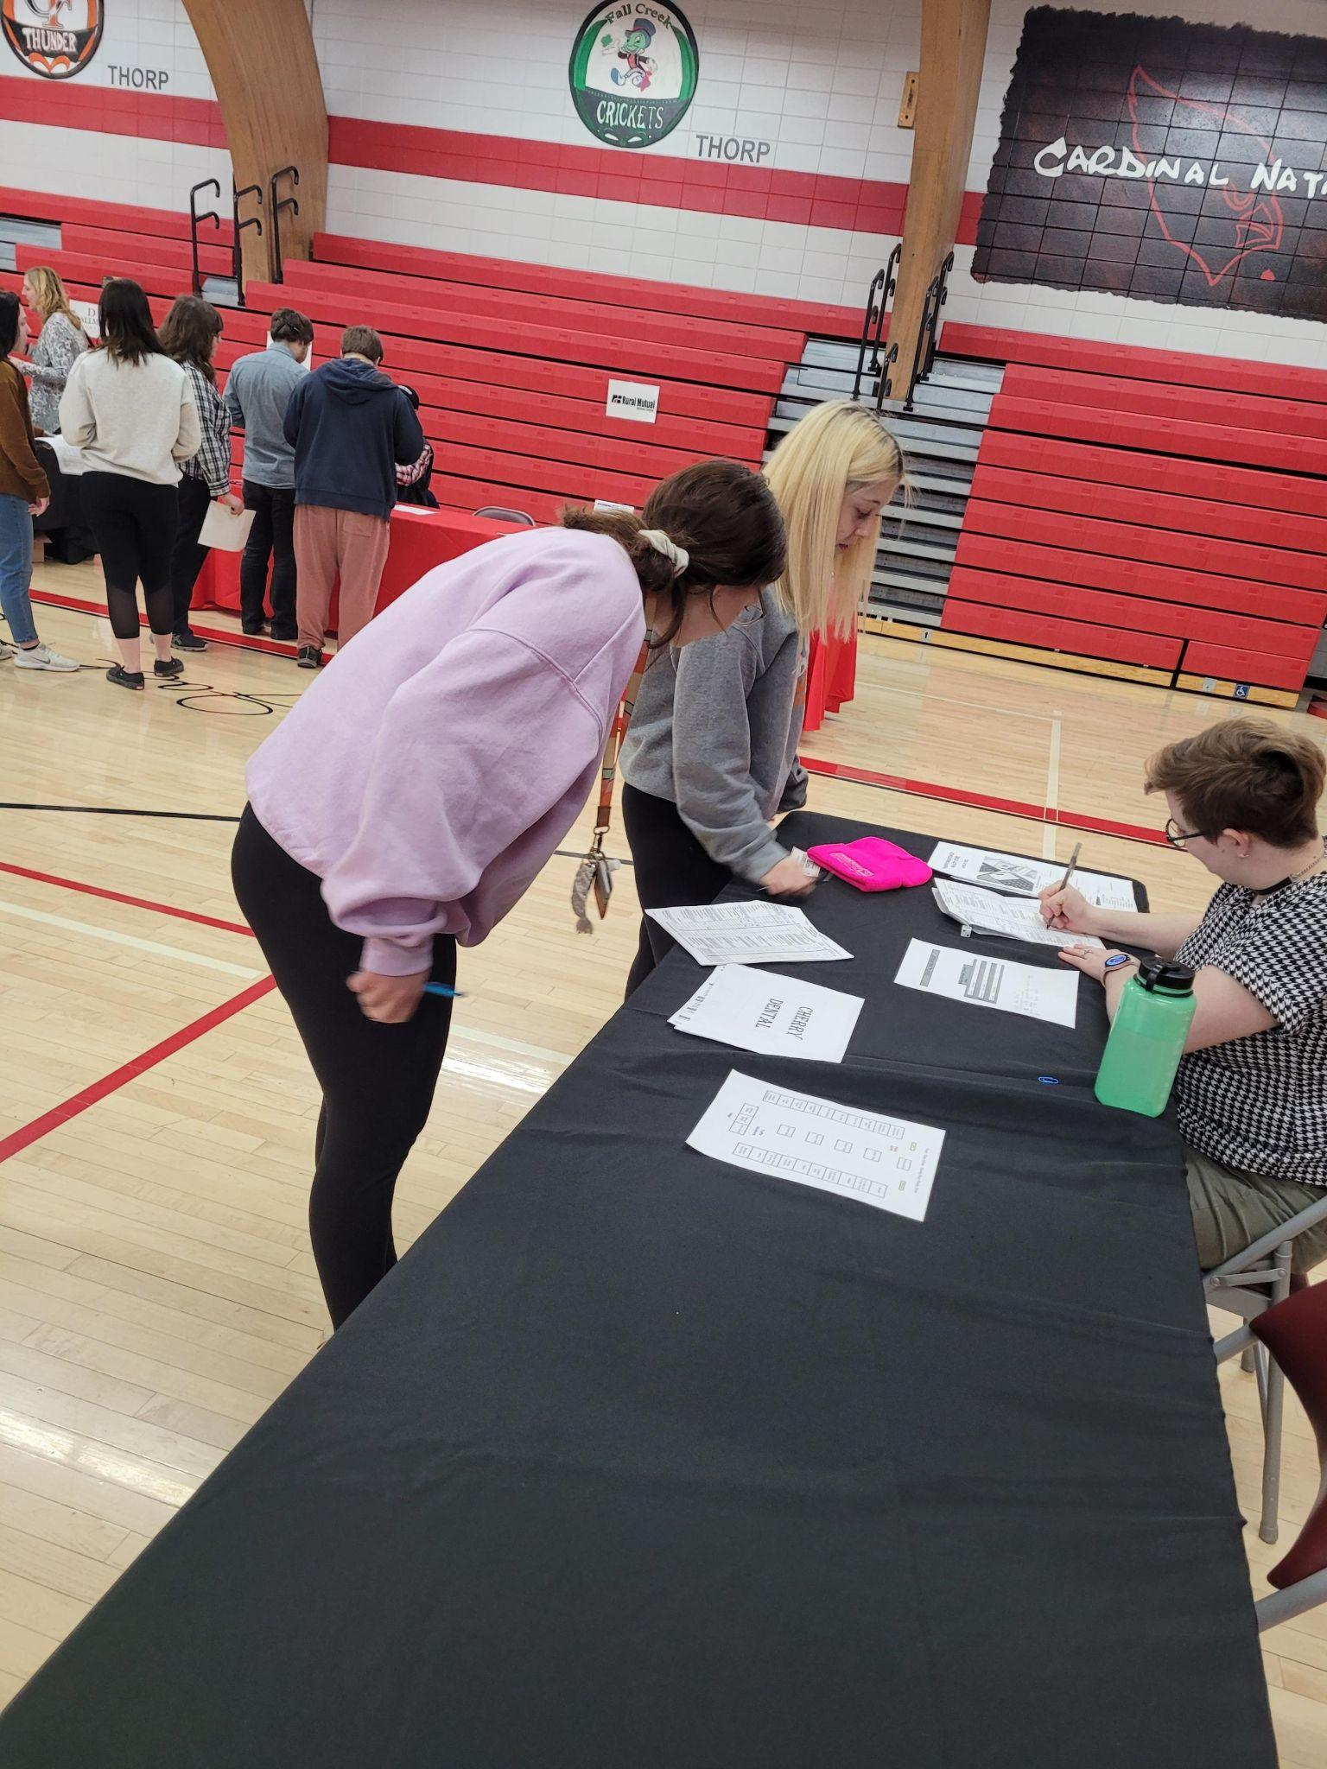
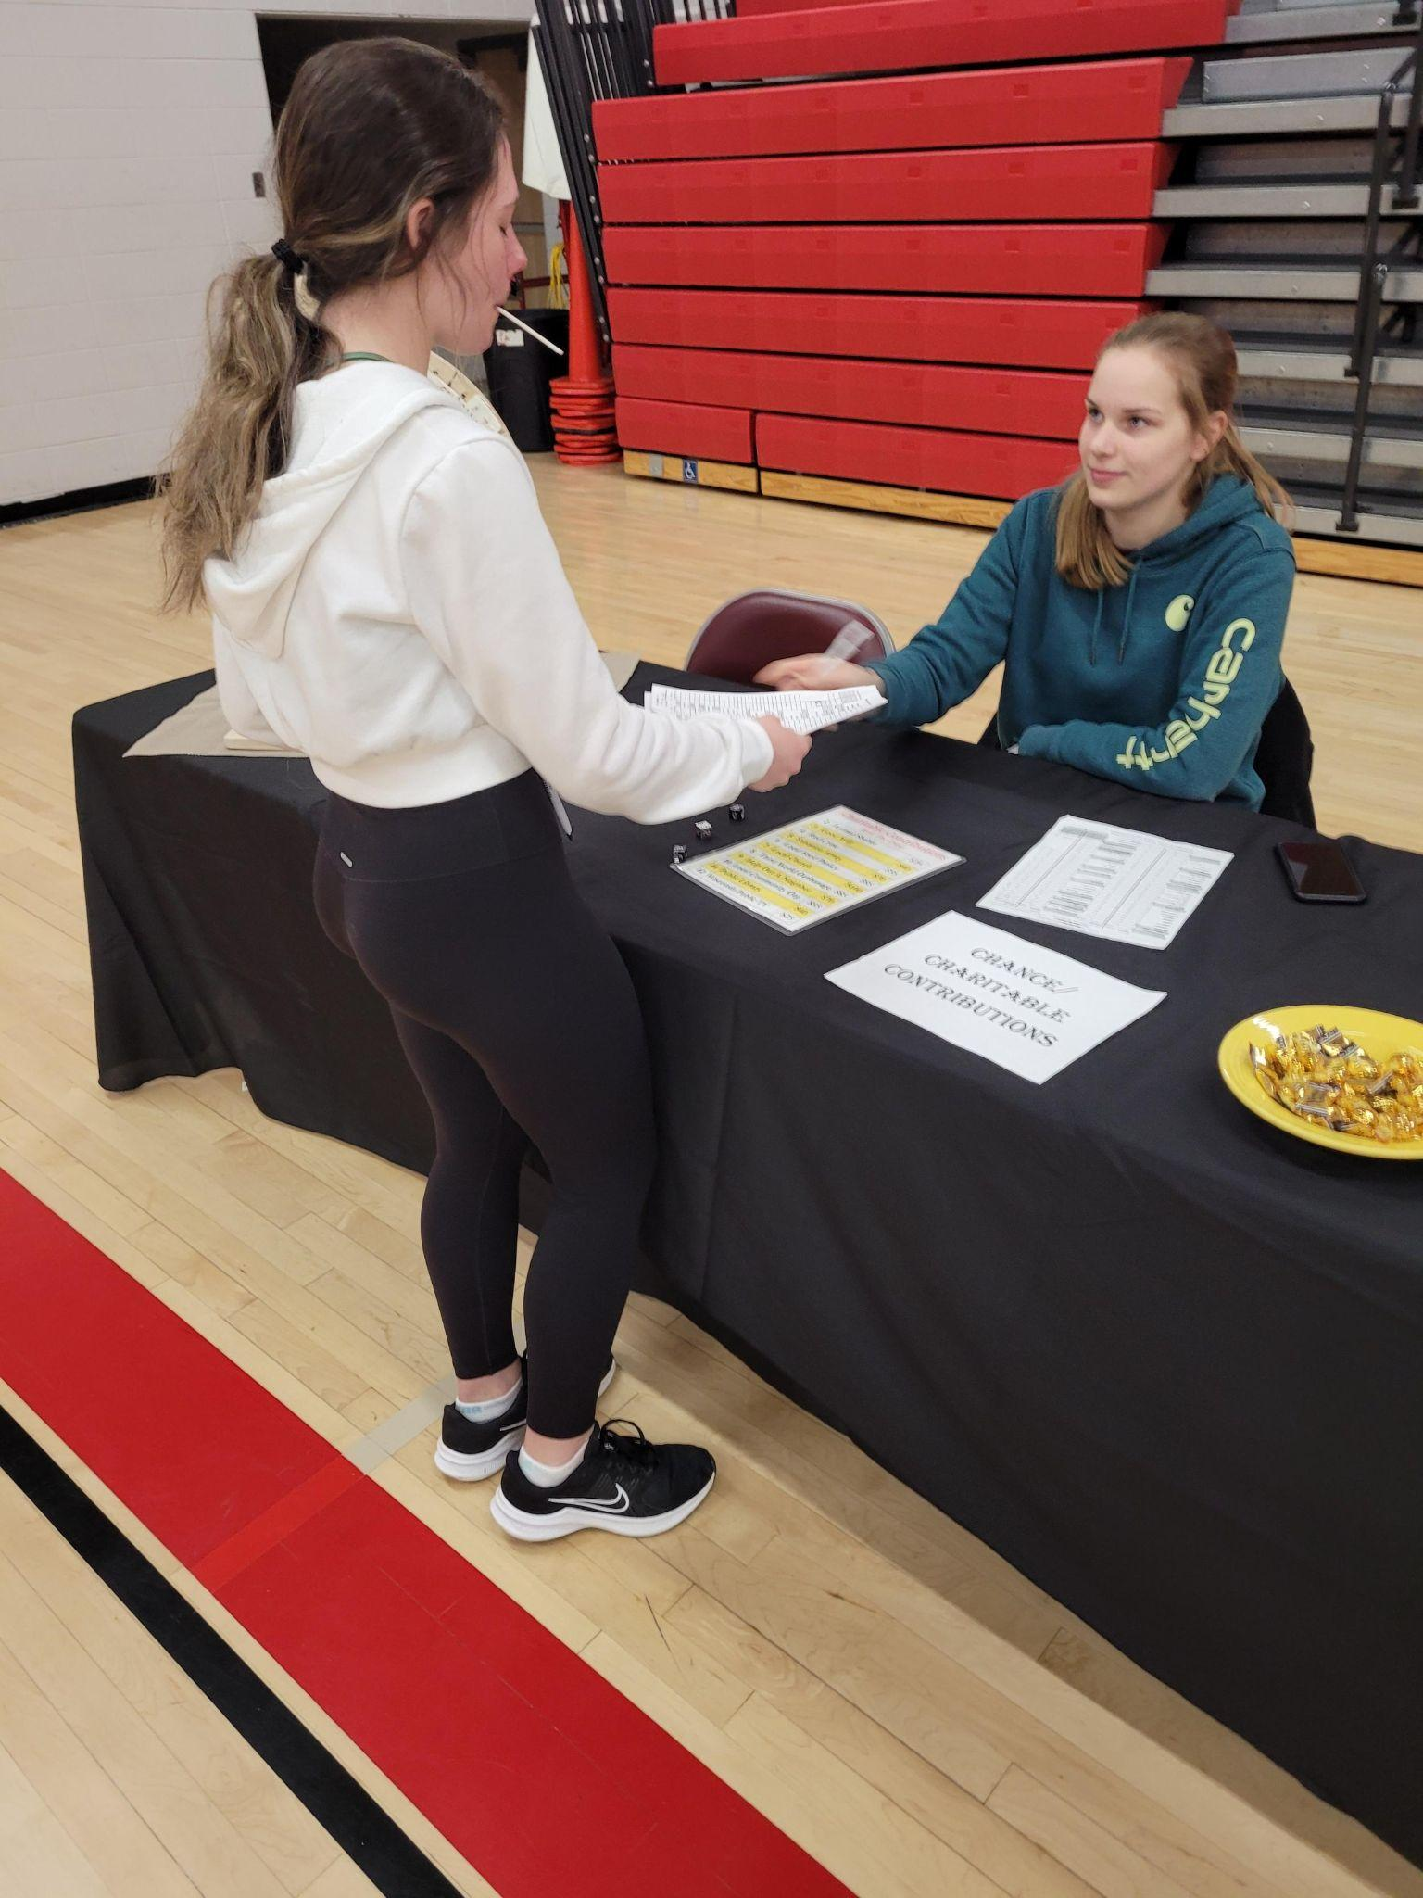
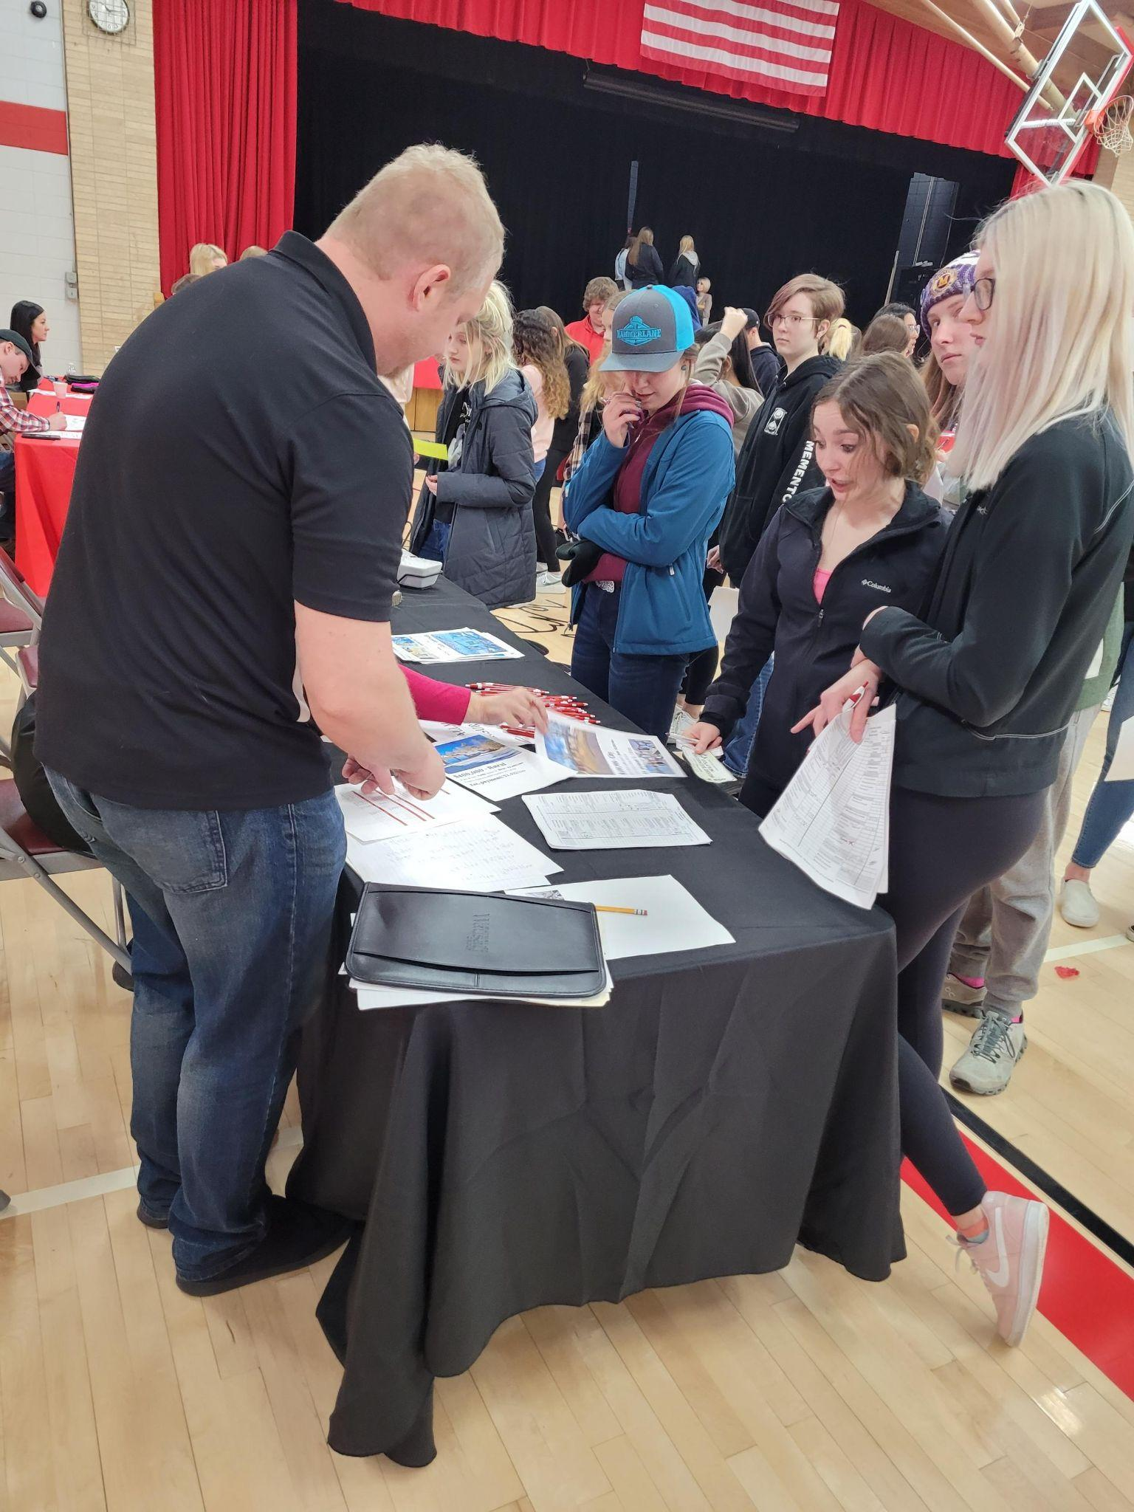
Reality Store

Slide 19
Have Fun!

Slide 20
Reflection
What we took away from this PBL is how much time and effort teachers put into their lesson plans. It also gave us an idea if we want to go into this field

Slide 21
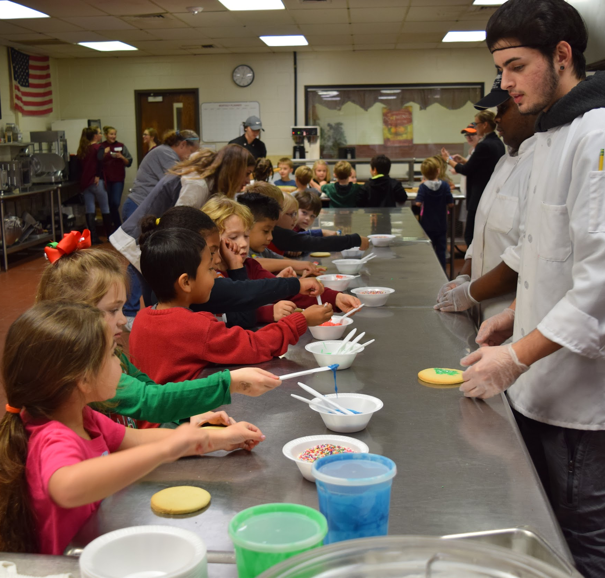
Did The Project Meet The Students’ Needs?
This project helped to inform many students who were still undecided on their post-secondary education plans.
They learned more about different career fields and they were provided with some college choices to look at.
YES! And they had SO much fun! :)

Slide 22
Thank You!
Have a GREAT day!

