Slide 1
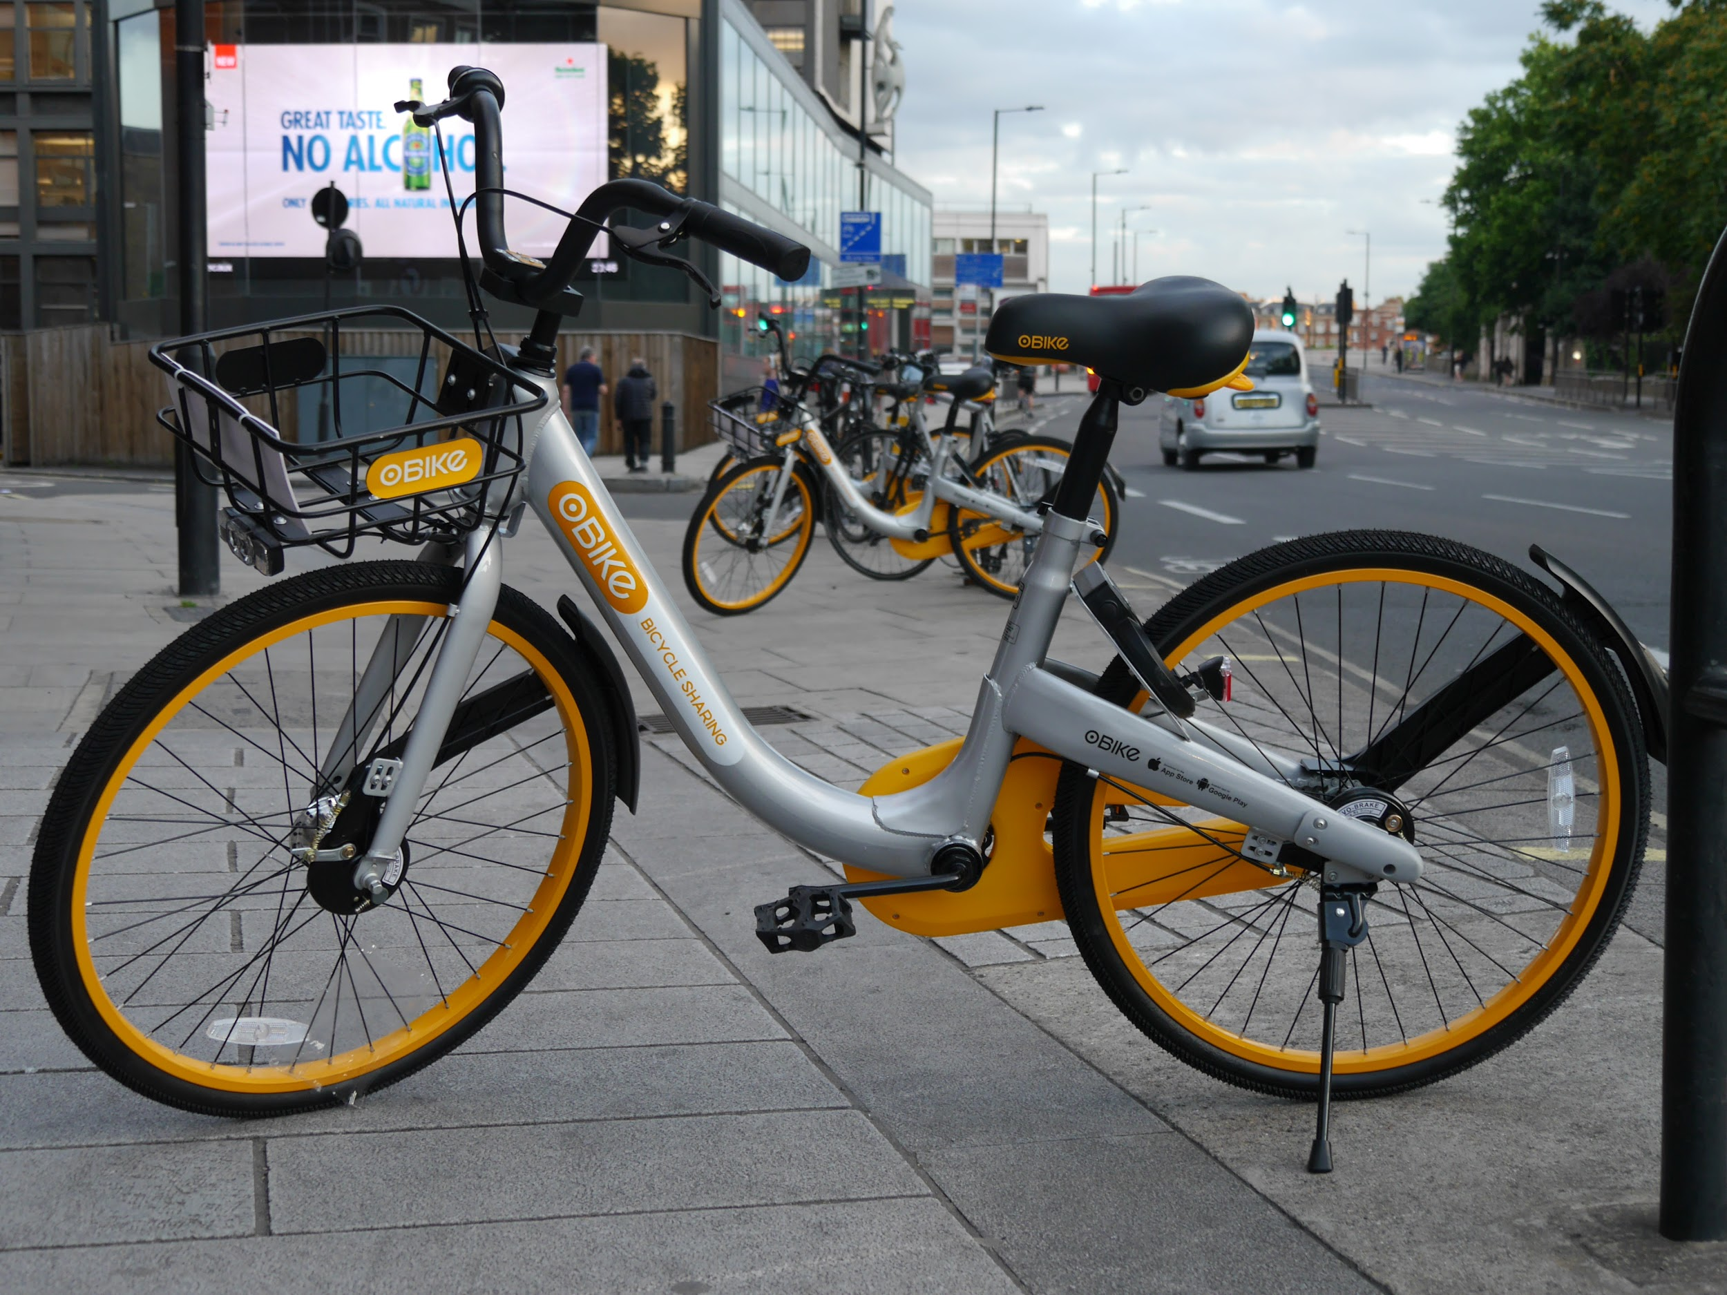
Re-Cycle

Slide 2
https://spark.adobe.com/video/kpiEpdWxOH0Jr

Slide 3

Executive Summary
Re-cycle is a green environmental friendly bicycle that stores and redistributes energy through the user pedaling. Get a workout and get to work with Re-cycle. Similar concept to the hand crank flashlight, the re-cycle bike makes you work to get rewarded. This encourages an active lifestyle while helping to reduce pollution from burning fossil fuels. The more you pedal the more time you’ll have to cruise off the stored energy you have worked for.

Slide 4

Market Research
85% of the American population owns a car (U.S. Department of State)
Only 62% of students at Madison High School reported themselves at a healthy weight (Maine Integrated Youth Health Survey)
The average American spends 26.4 minutes traveling to work (U.S. Census)
The re-cycle bike will help fix these problems. For one this can help reduce the obesity rate by giving people a reason to actually want to exercise. It can also get people who only travel short distances daily a chance to avoid the traffic they have to deal with when they are driving a car. Why not spend that time on the Re-Cycle?

Slide 5
Market Research (continued)
Main Competition: Hybrid car and motorcycle companies like Prius, Nissan, and Harley Davidson.
Why we work: We will appeal to every single reason why a person loves cars. We will have radio, heated seats, and very good mileage per charge.
Our Location: We are opening our company in cities like New York, Boston, and Washington D.C, where bikes would be very useful.

Slide 6
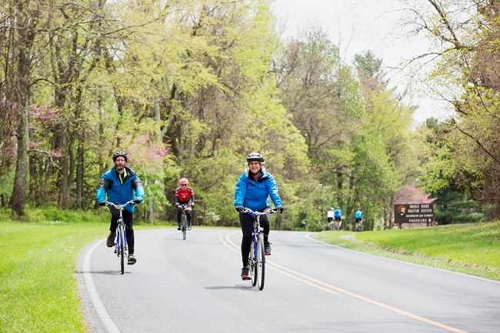
Marketing Strategy
Our Audience: Environmental friendly, exercise enthusiasts living in bike friendly areas.
Our Target Area: Bike Friendly Cities in Warmer Climates.
Our Benefit: This will give people who are against using fossil fuels a chance to get places without using a regular bike that needs to be pedaled the whole time.
Our Strategy: To get our name out there we could start by advertising on popularly used social media such as Snapchat, Instagram, Facebook Marketplace, Twitter.

Slide 7
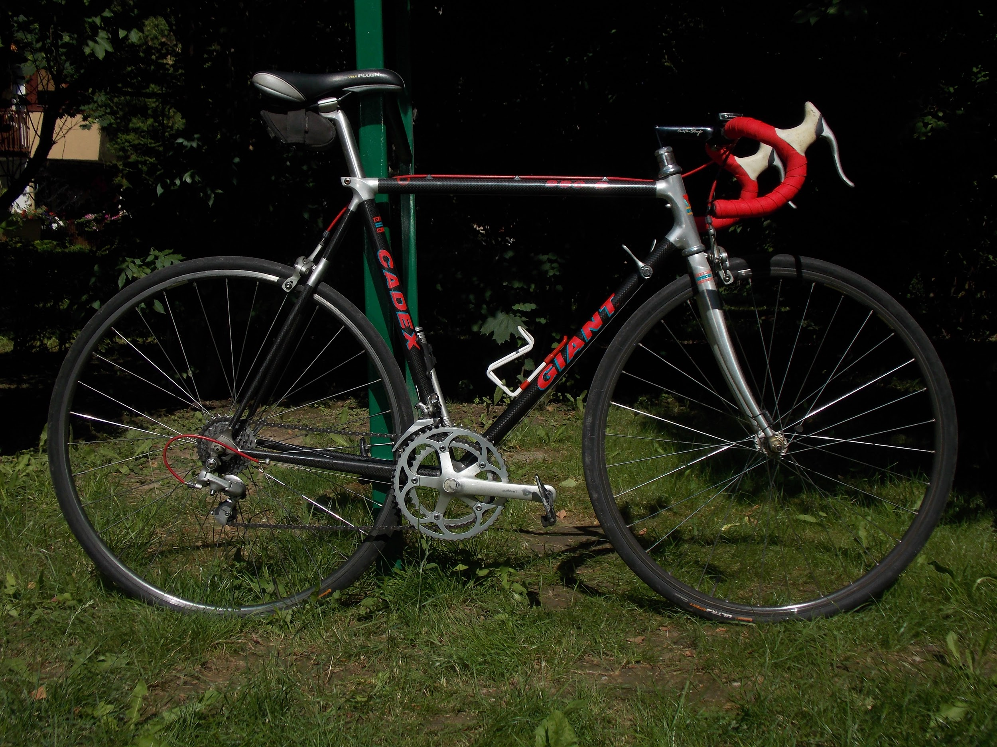
Financial Plan
Revenue:
The Re-Cycle bike will start at $10,000 and prices may vary depending on different models that are designed.
This price is determined due to the cost of manufacturing, shipping, and maintenance services. It costs approximately $6000.00 to build the whole bike. When manufacturing and shipping come into the picture it raises the price about $1500.00, with a total production cost of $7500.00 and a profit of $2500.00 per bike.

Slide 8
Financial Plan (continued)
Cost Structure:
Our start-up costs will include the cost of buying and building the machines, the price to rent or lease a building to act as our main production studio including utilities, employee salaries, and marketing costs. We will need a 5 million dollar loan to cover these costs.
With a profit of $2500.00 per bike we would need to sell 200 bikes per year to pay off our 5 million dollar loan over a 10 year span
Partners:
We would try partnering with local bike shops, such as Mathieu’s in Oakland, Maine and engine repair companies, such as Huffy.

Slide 9


