Slide 1
Understanding Appropriate Dress Attire for the I & I Ceremony
Dress to Impress!!!!!

Slide 2
How Formal or Informal?
As a Career Association, think about how formal or informal you want your I & I Ceremony to be.
Things to consider:
Do you want your event to be informal where you and your guests wear casual or business/casual attire?
Casual events usually happen during the day.
Casual events usually will not have a formal dinner.
Do you want your event to be formal, where you and your guests wear business attire
Formal events usually happen during the evening.
Formal events usually will have a formal dinner.
Remember, you will be inviting important guests including your family, school faculty, and community. You want to dress to impress your guests.
Make sure you include the type of event and dress attire on your invitation, so they know the appropriate attire.

Slide 3
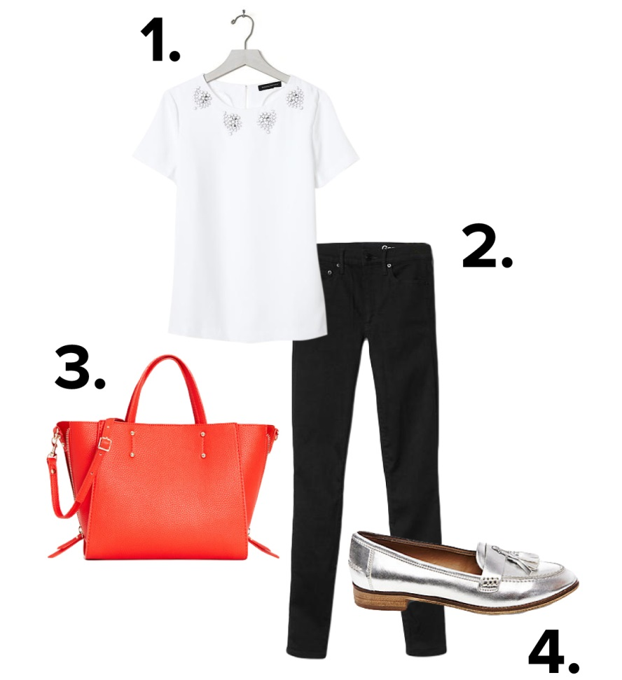
Casual Example
For women, you could pair dark denim with a blouse and some simple jewelry. The key is to look polished. The top should be dressier to balance out the denim and you should absolutely wear a professional shoe with this look. If you do not have a nice blouse, you could wear a solid-colored polo.

Slide 4
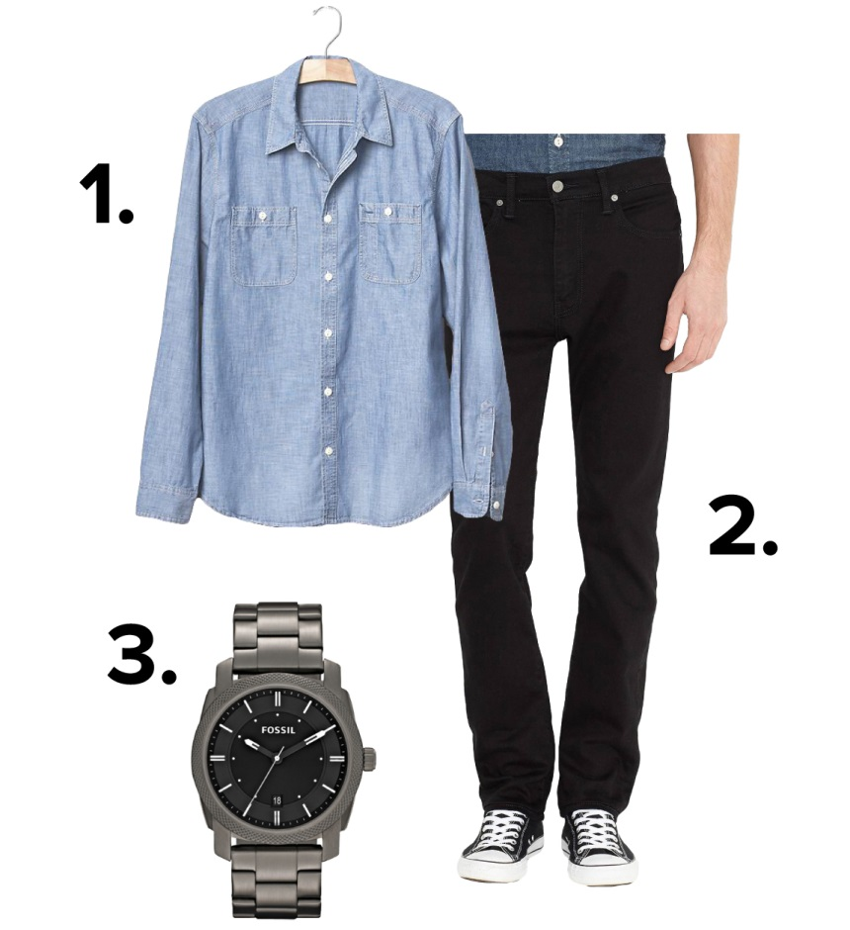
Casual Example
For men, it’s about sending that same message: casual, crisp, and clean. I highly recommend a collar because t-shirts won’t cut it. Dark denim paired with a shirt with good lines A man might be able to get away with sneakers but they should be dressy sneakers, not your cross trainers. A denim shirt or polo style shirt is a fantastic look for a casual-smart look.

Slide 5
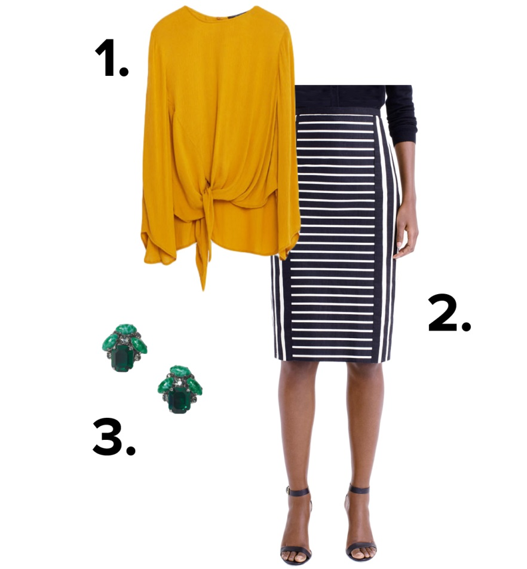
Business Casual Example
When in doubt, it’s almost always business casual. For women, business casual attire is a sharp button-up shirt or a conservative blouse paired with trousers or a skirt. You could also wear a tailored dress. Shoes should absolutely be business appropriate - flats, loafers, or heels.

Slide 6
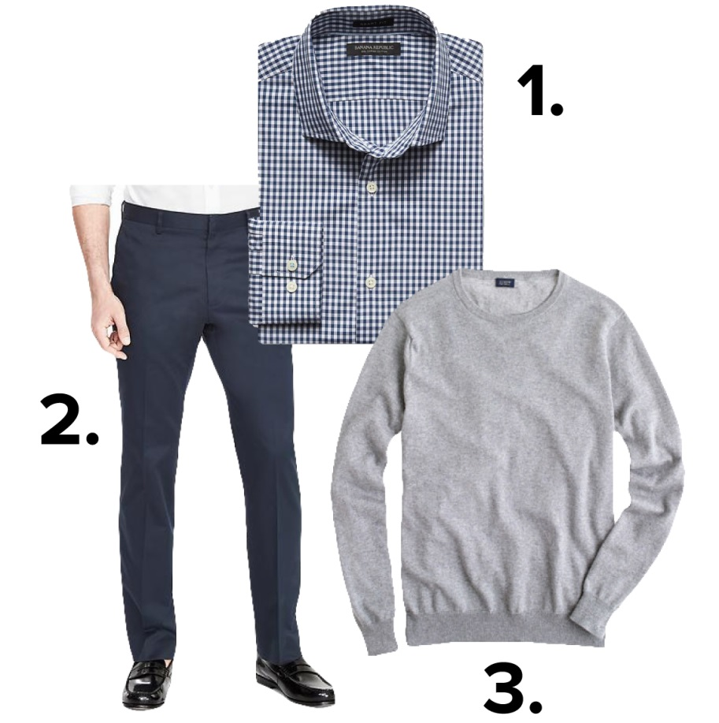
Business Casual Example
For men, business casual attire means collared shirt, tie-optional, and dress pants. While a jacket is optional, it sets a polished tone. Here is a great opportunity to show your personality by the use of colors. Show your personality with a unique shirt or suit color. If you’re totally against a jacket, you could wear dress pants with a dress shirt under a nice sweater.

Slide 7
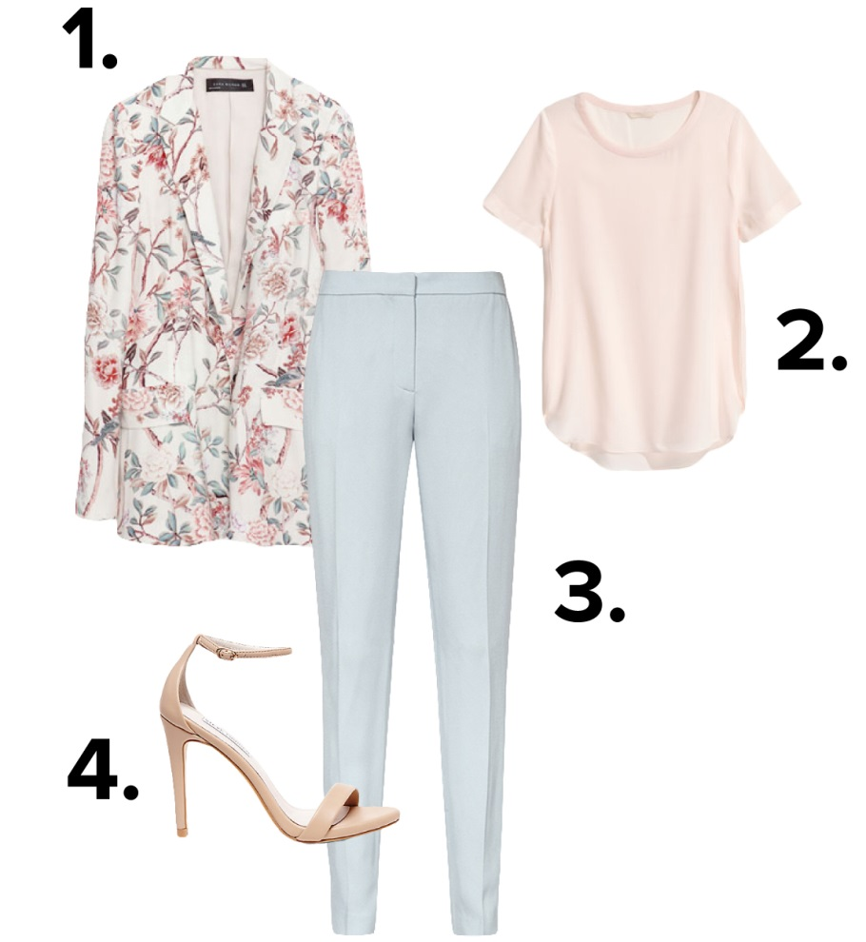
Business Example
Business means that you want to look as tailored as possible. For women, you don’t have to wear a traditional suit. You can show off your personality and achieve the dress code just as well. Stick to the rule of dress pant/skirt and jacket and a nice blouse and shoes.

Slide 8
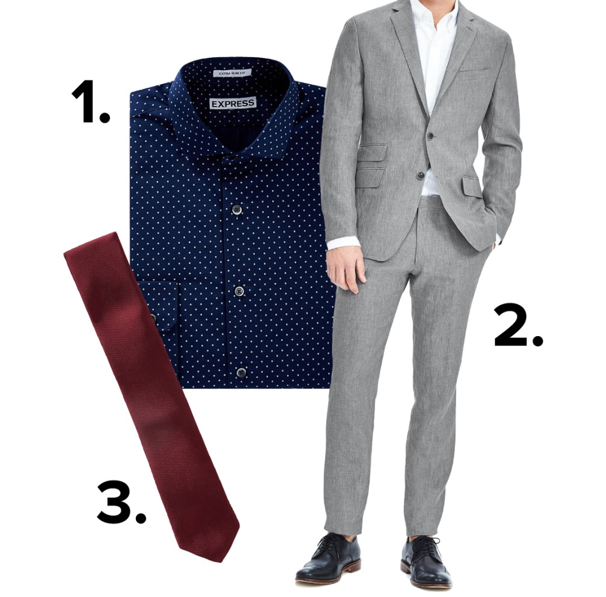
Business Example
For men, unfortunately your clothing options are limited. You’re going to have to wear a full suit with a tie. But, you can spice it up by adding interesting pieces like a vest or a sweater that will add some dimension to your otherwise look. Red ties symbolize POWER.

Slide 9
Things to Remember
Be true to your style and comfortability. Be happy with what you are wearing!
Don’t wear things that you know will make you uncomfortable
If you do not usually wear high heels, then you may be in pain all day until you take them off. If you are in pain all day, you will not do your best.
If you put on a suit, if you aren’t used to wearing a tie and suit, you may be adjusting and tucking all day. If you feel restricted you will not be your best self.

Slide 10
Other Things to Remember
You do not have to buy expensive clothes.
Hair should be clean and combed.
Fingernails clean.
Iron your clothes if needed.
Brush your teeth and don’t forget deodorant.
For women, wear appropriate undergarments so your clothes appear smooth and sleek.

Slide 11
Things Not To Wear!
For women, stay away from the following:
Too much jewelry.
Tennis shoes
Flip Flops or open toe sandals unless it is a heel.
A ton of makeup
Low cut shirts and high skirts
T-shirt or sweats
Formal dresses
Earphones or sunglasses
Fish net stalkings
3 inch heels
For men, stay away from the following:
Tennis shoes
Flip Flops
T-shirt or sweats
Wearing whites socks with dark pants
Earphones or sunglasses

Slide 12
Finding Clothes on a budget
Second Hand stores/ Thrift Stores/Vintage
Look for:
Suits, Jackets, Shirts, Ties, Shoes
Average outfit= $20.00

