Slide 1
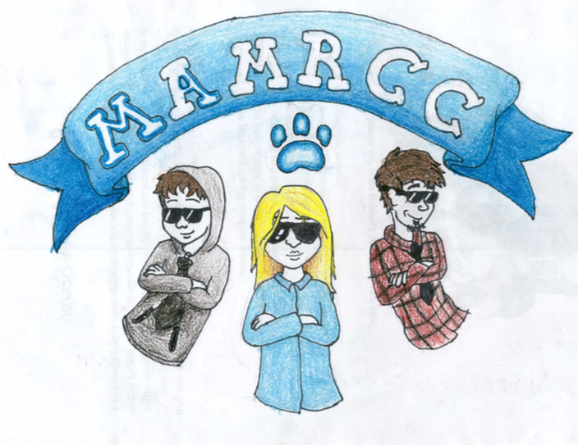
M.A.M.R.C.C.
Madison Area Memorial Recreational Community College

Slide 2
Business Pitch
MAMRCC

Slide 3
Business Summary
MAMRCC is working to increase the percentage of the community members with post secondary education by providing local affordable hands on college courses, including two-year and four-year degrees, for those looking to improve their career or start a new career path. We also offer a wider variety of recreational activities and dining options to our members to encourage healthy living styles. Our targeted community members will be from Carrebec, Skowhegan, and of course Madison!

Slide 4
Market Research
16% of the population in Somerset County has a bachelor’s degree compared to 30% in Maine.
Our closest competitor, Kennebec Valley Community College, is 20.2 miles away or a 30 minute drive.
In Somerset County, only 81.2% of people have computers, and only 70.2% have internet but within the next decade 77% of jobs will require technology skills. We will provide internet and computer labs to our students
Our local affordable option will save time, money for fuel, and make education a possibility for more!

Slide 5
Marketing Strategy
Flyers and Pamphlets @ Local Grocery Stores, Recreational Stores, Guidance offices at Schools
Register at our Student Service Center or online at www.mamrcc.edu.
Our website would showcase our variety of courses from astronomy to the medical field, and our range of recreational activities including skate parks, weightlifting gyms, and tennis, badminton, and basketball courts.

Slide 6
Financial Plan
REVENUE:
COST STRUCTURE:
We will need $125,900 to purchase 153.76 acres of land on Reed Rd. Our funding strategy is to fundraise, find investors for our business, charge memberships/class fees, and partner with sponsors to help pay for equipment and etc.
Type of Fee | Cost
Monthly Membership for Recreational Activities | $80
Payment Per Semester Class | $125
Payment Per 2 Semester Class | $150
Monthly Dining Card | $50
*Depending on family income, you can qualify for financial aid and or scholarships

