Slide 1
Alfa Max
One task, One job, One family

Slide 2
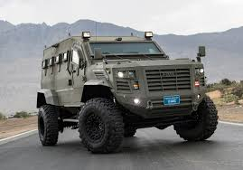
Business Pitch
Our Promotional Video

Slide 3
Business Summary
We are solving the loss of jobs in somerset county. We are also looking to bring people back to the area and put Madison back on the map.
We are turning the mill back into a working powerhouse. Producing military products. With this it will bring attention to madison. While bringing engineers and mechanics to and back to Madison.
Our company will produce Military vehicles including Humvees, and Helocopters for the government.

Slide 4
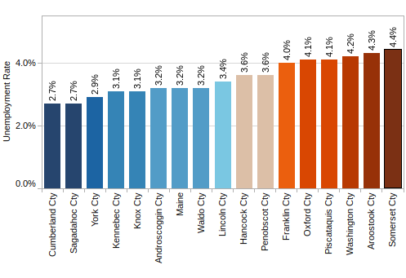
Market Research
In the last 10 years Somerset County's population decline is up 3% that's huge. Also the unemployment rate is the highest in Maine (4.4%). With Alpha Max we’re looking to fix this problem. We are also looking forward to help supply the military with more and better products; helicopters, hummvee, ripsaw, and more.
We will be putting our products through a field of tests including penetration tests with low and high caliber rounds. Also we will be testing explosion and road bomb testing
These will be showed in showrooms and will be the only product sold to the public.

Slide 5
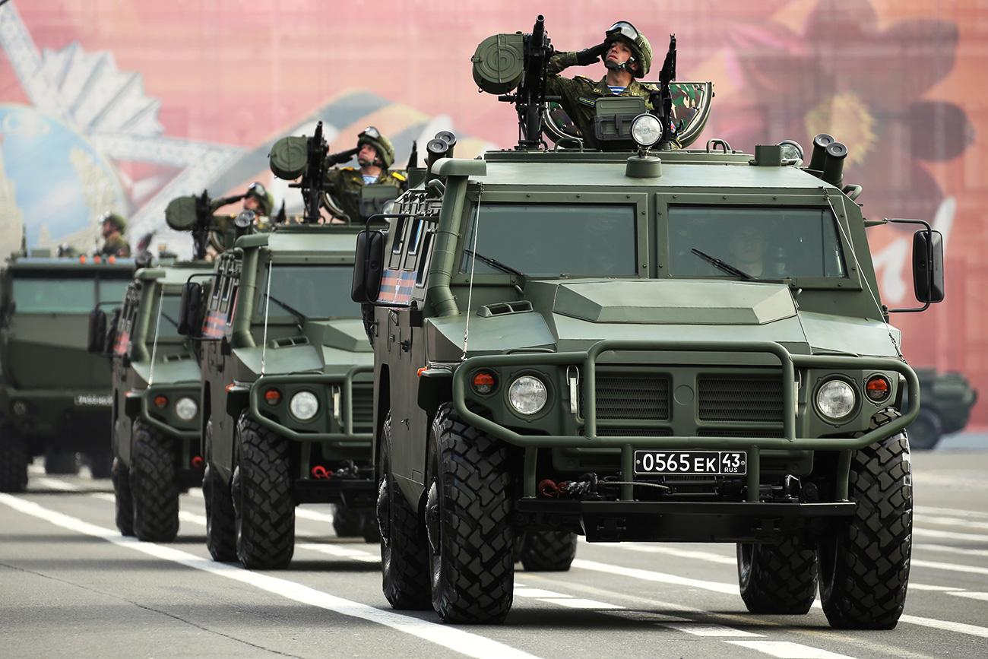
Marketing Strategy
Our product will be contracted with the United States Government. Our target audience for our public products will be people living in areas where off-roading is available especially in rural parts of the United States. We will advertise online through our website and social media for our public products only. Our government contracts are confidential and will not be advertised.

Slide 6
Financial Plan
We will be making armoured Humvees with better blast and penetration technology and helicopters. Every humvee unit cost 30,000$. Every Helicopter unit cost 6 million dollars.
By getting a Government contract and other grants and loans we are estimated to be spending $21,000,000 for first year costs.
Building (Mill) - 2.5 Million Runway Strip- 2 Million, Development and Manufacturing Cost: Annual Cost: $10 Million, Engineers- $100/hr @ 40 hrs a week x 10 Employees= $40000 x 4=$160,000 Manufacturers- $25/hr @ 40 hrs a week x 100 Employees= $100,000 x 4= $400,00

Slide 7
Finical Plan
Our funding strategy is pretty simple. We will be looking into grants and a government contract. For the first year we will be looking to take out a 35 million dollar loan. At this rate with around 40-50 million dollars in revenue in the first year alone we will be able to pay back the loan in a 2 year period.
A good business partner would be Howe and Howe because they are experienced in the business and they have connections that would be very useful.

Slide 8
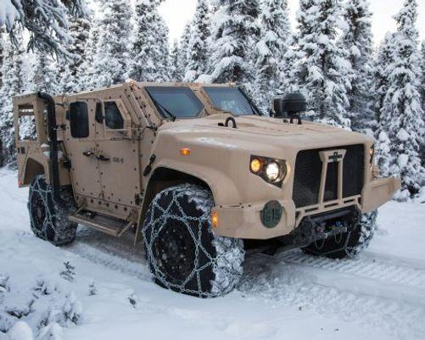
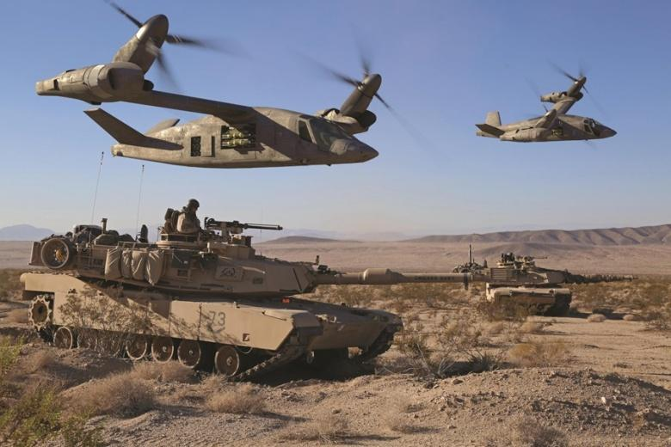
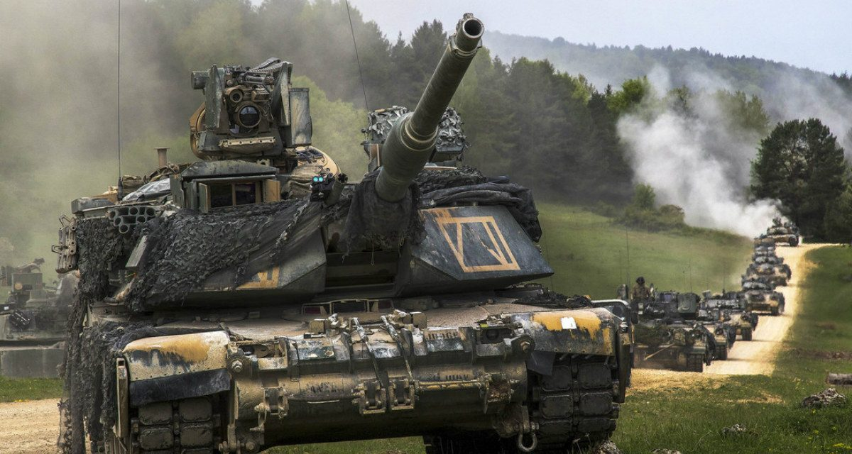
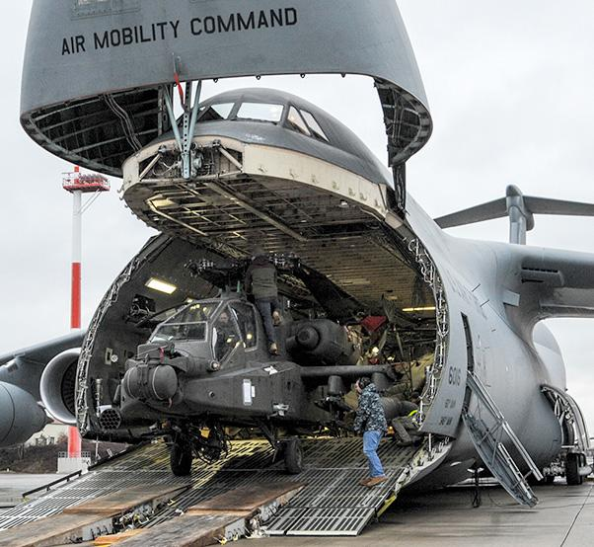
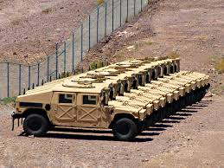

[Other]

